Slide 1


Project Presentation
Course Work – 2
M00789313

Slide 2
Contents
Introduction
Data analysis & Visualization
Data mining Algorithm & Data Pre-processing
Data Mining
Data Ethics
Conclusion

Slide 3
Introduction
The "Supermarket Sales" dataset from Kaggle contains sales data from a chain of supermarkets across three countries over three years
Data cleaning involves removing duplicates and missing values, converting data types, and removing extraneous columns to ensure reliable analysis
Outliers and inconsistencies are also repaired to ensure accurate analysis
Data analytics and visualization techniques are used to explore the dataset and uncover trends and patterns
Selecting a reliable data mining technique is crucial to identifying meaningful relationships among variables in the dataset
Ethical considerations such as data privacy and confidentiality must be taken into account when using the dataset
The investigation will lead to conclusions, limitations, and challenges with viable solutions

Slide 4
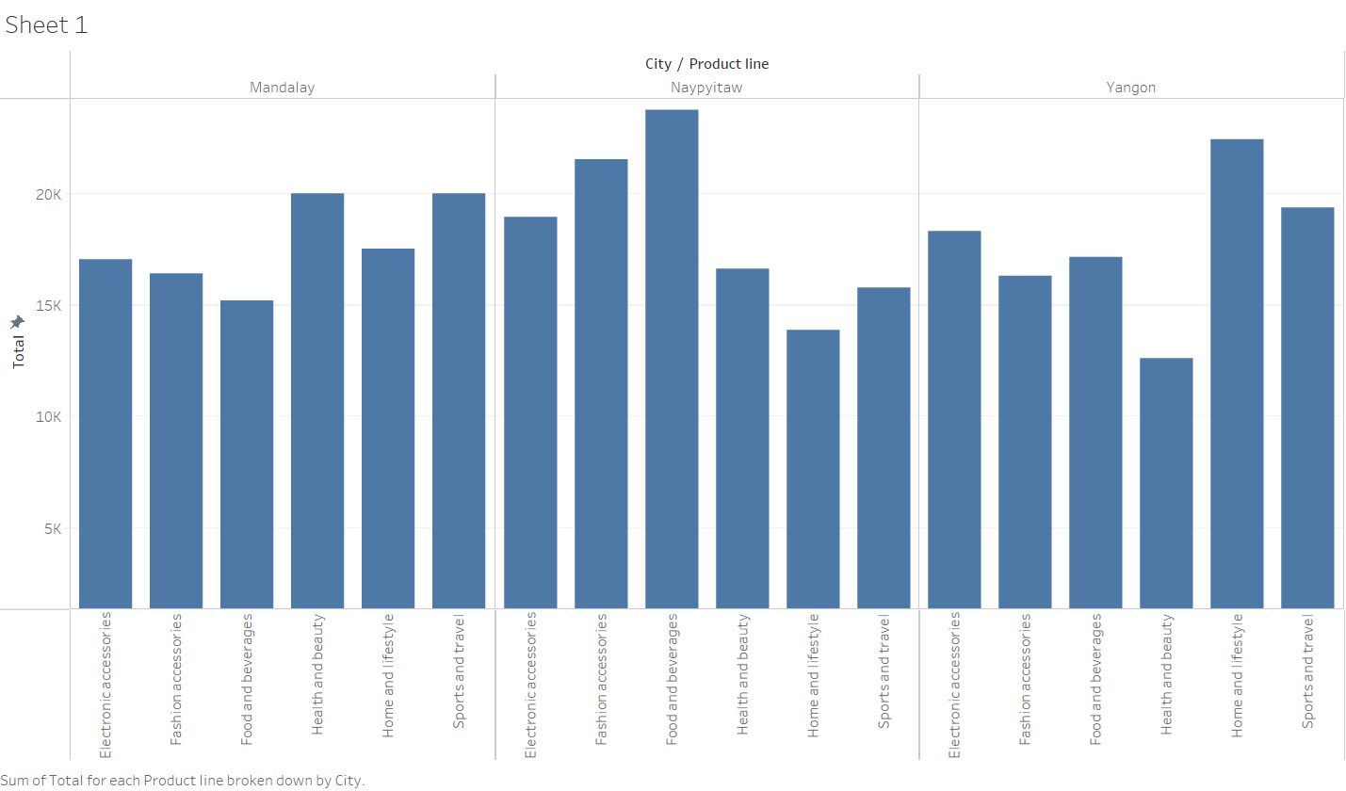
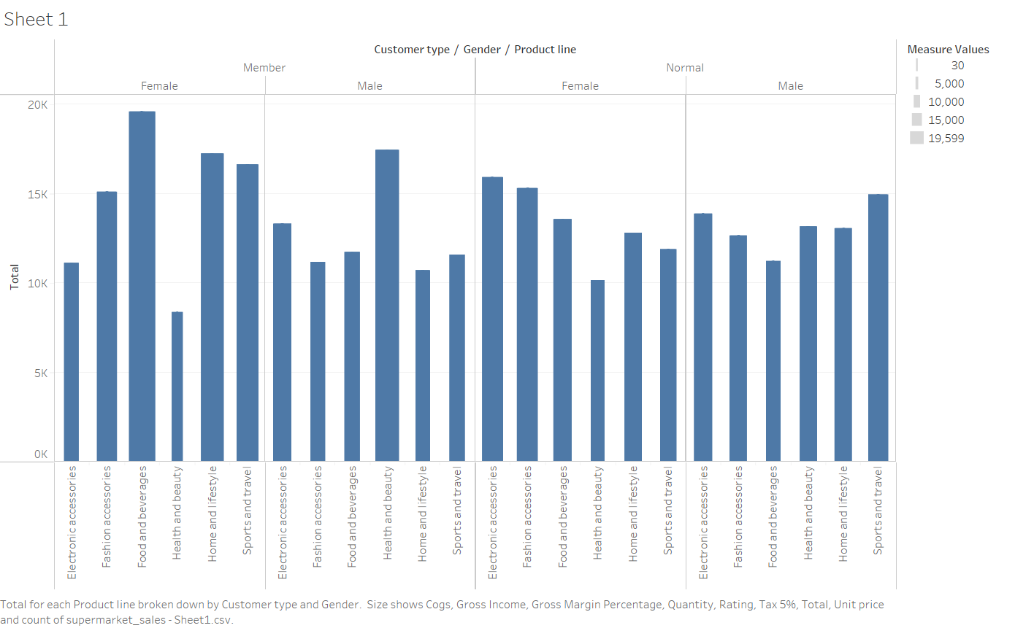
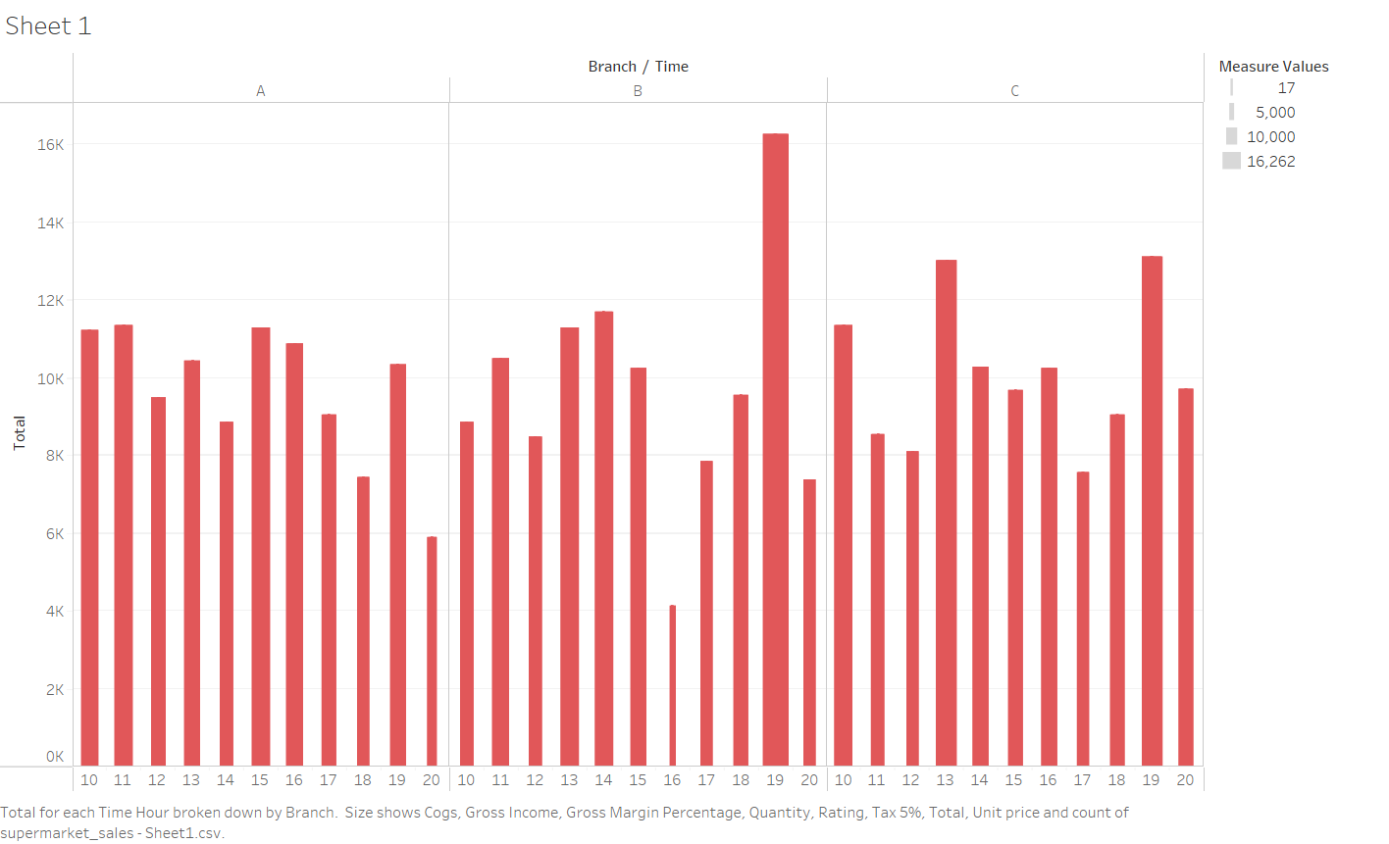
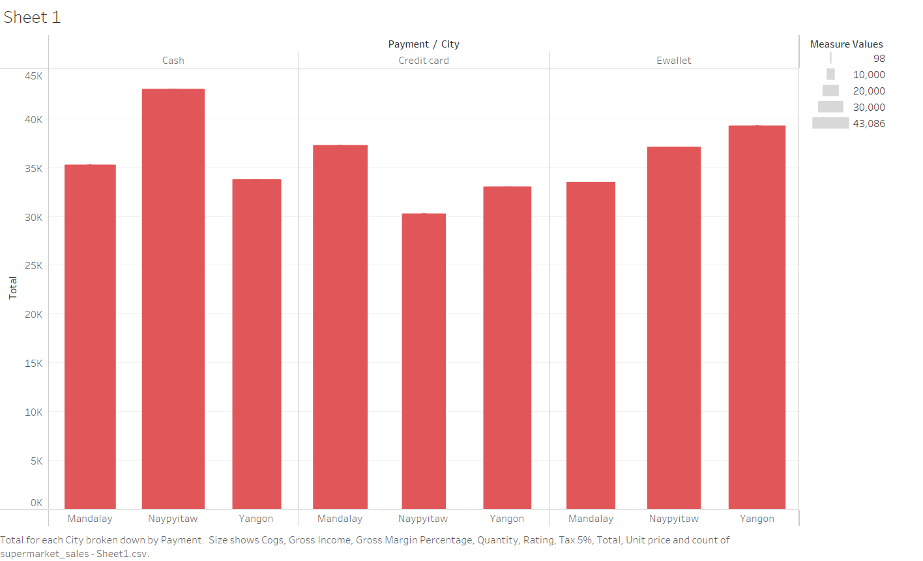
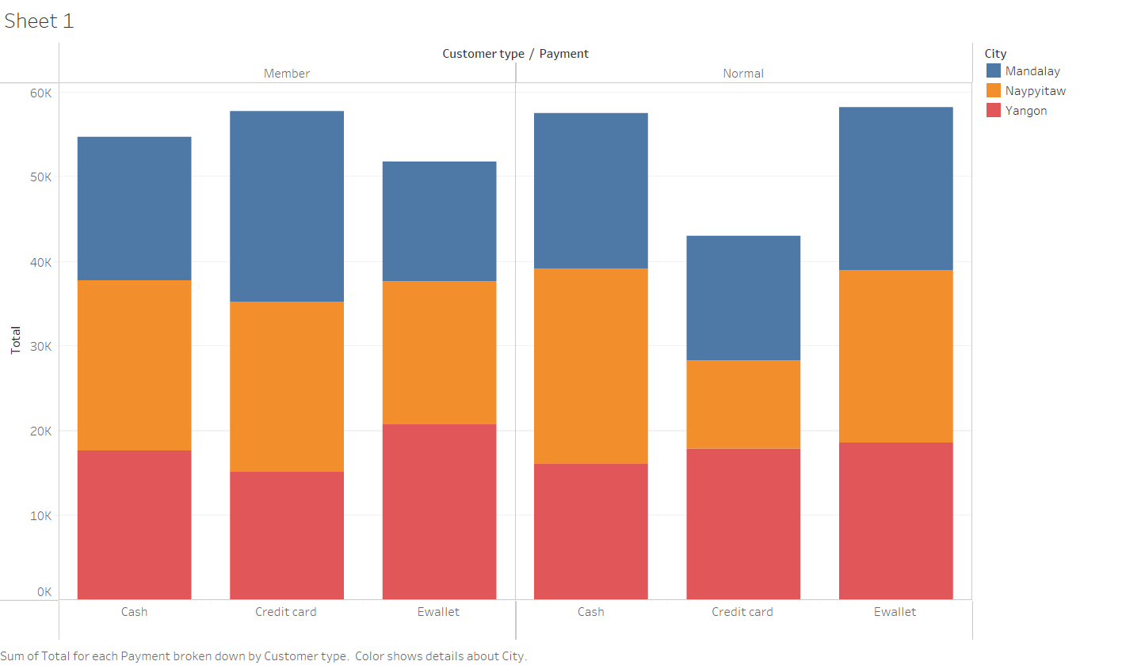
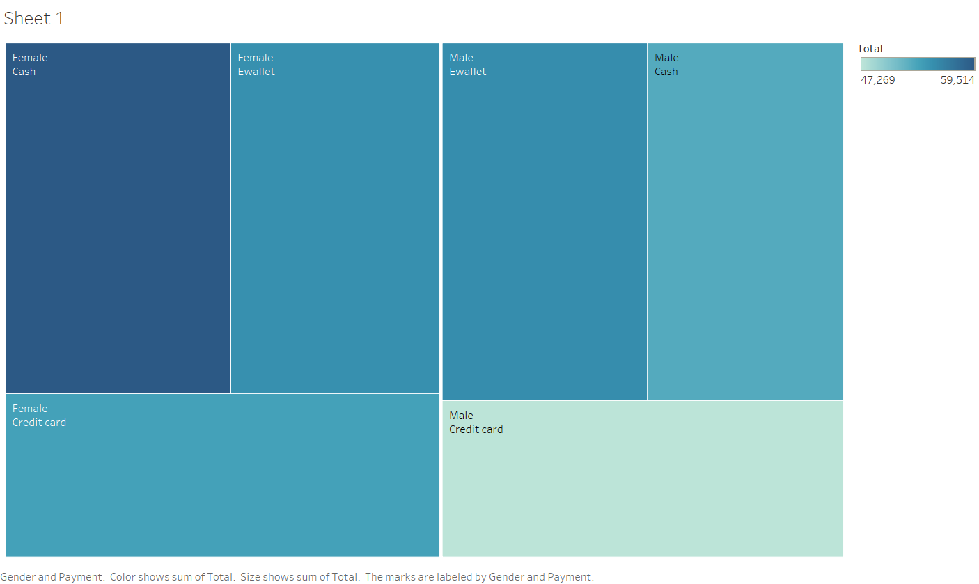
Data analysis & Visualization
Sales made by a product Line in a city Sales made according to product line to customer Sales made in each branch acc to time
Method of payment in cities Method of payment by customer type Preferred payment method by gender

Slide 5
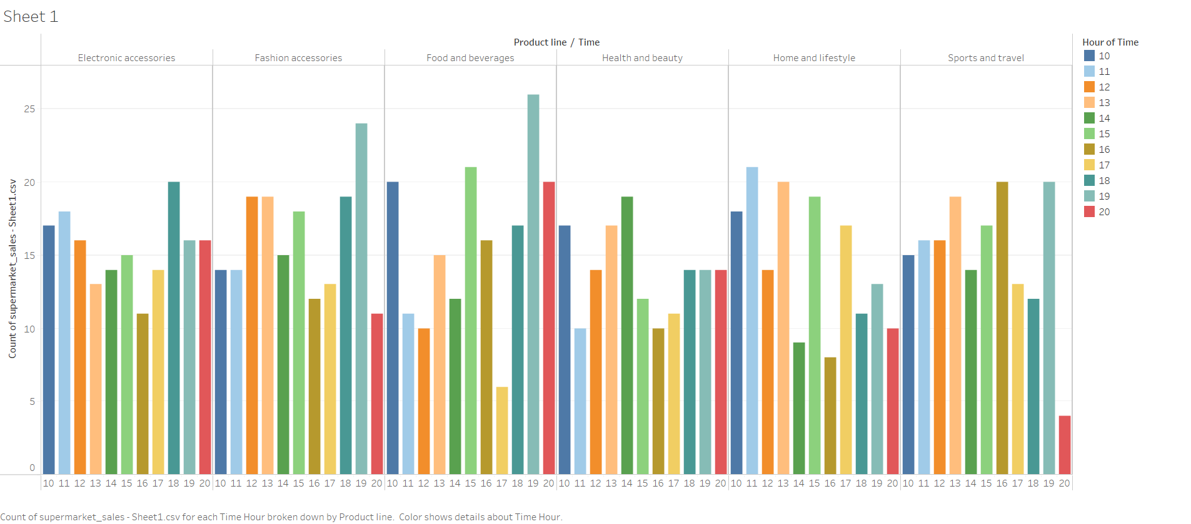
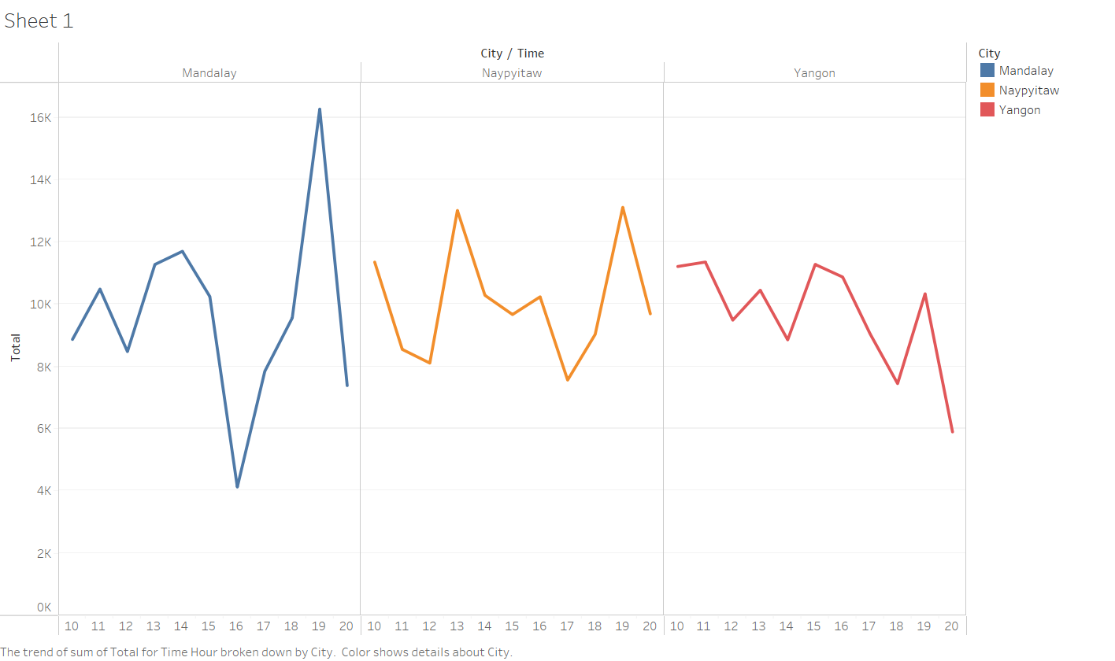
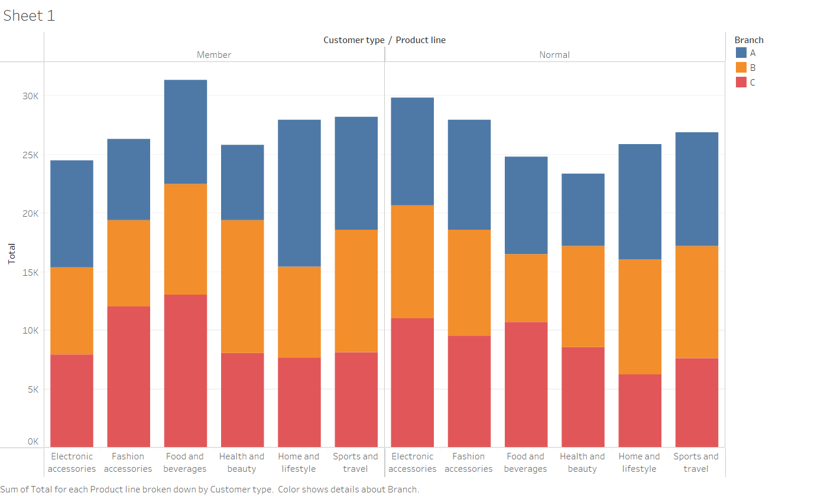
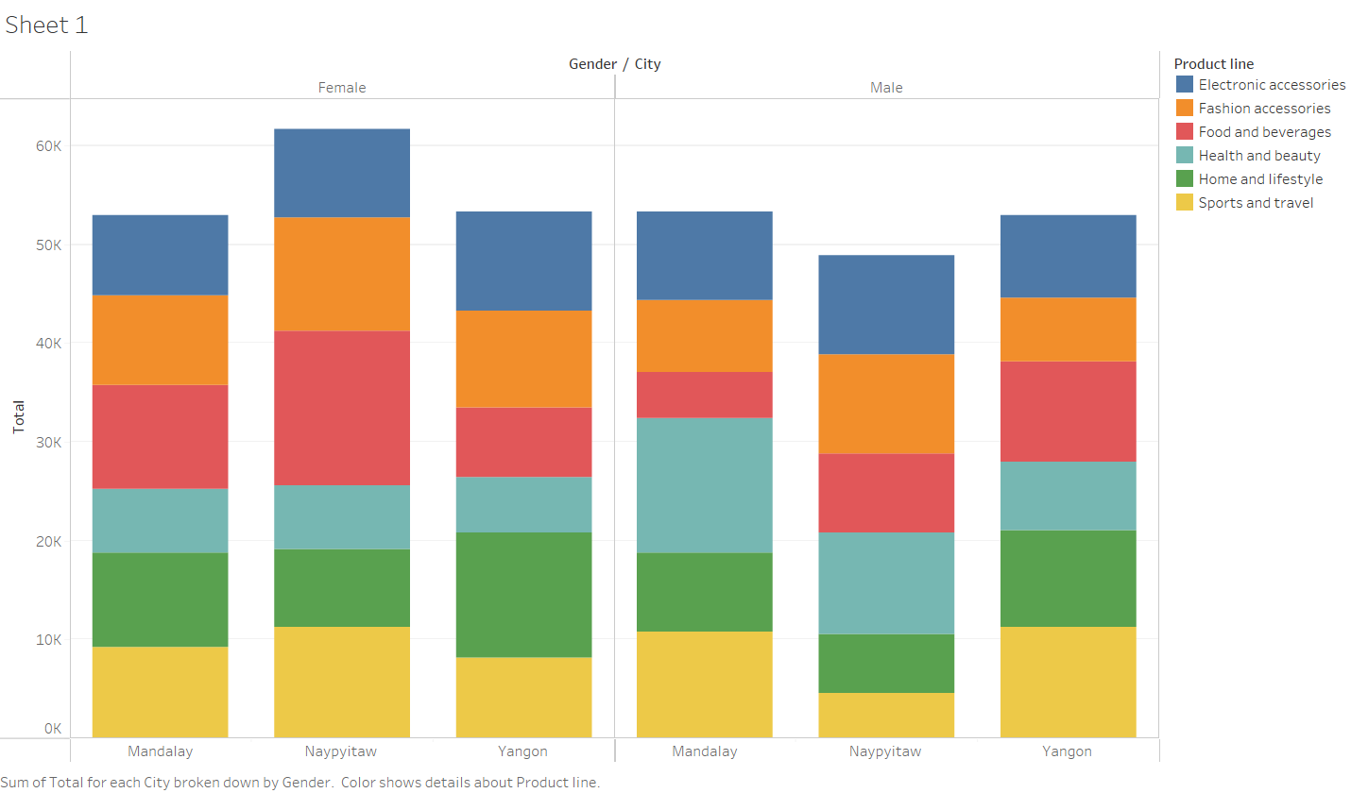
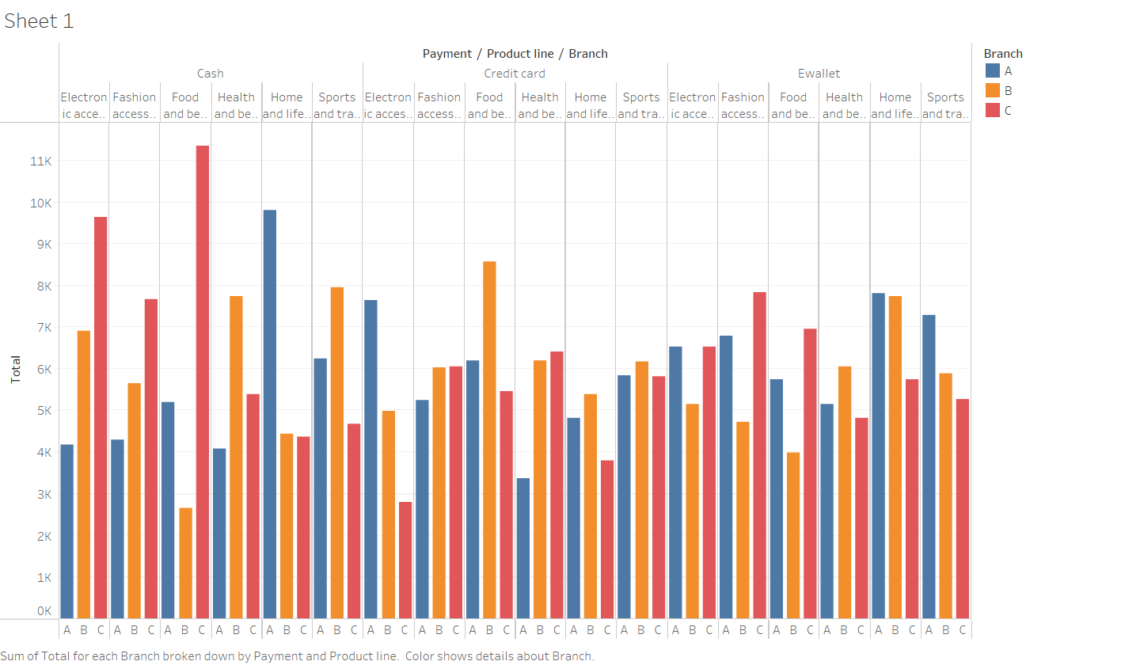
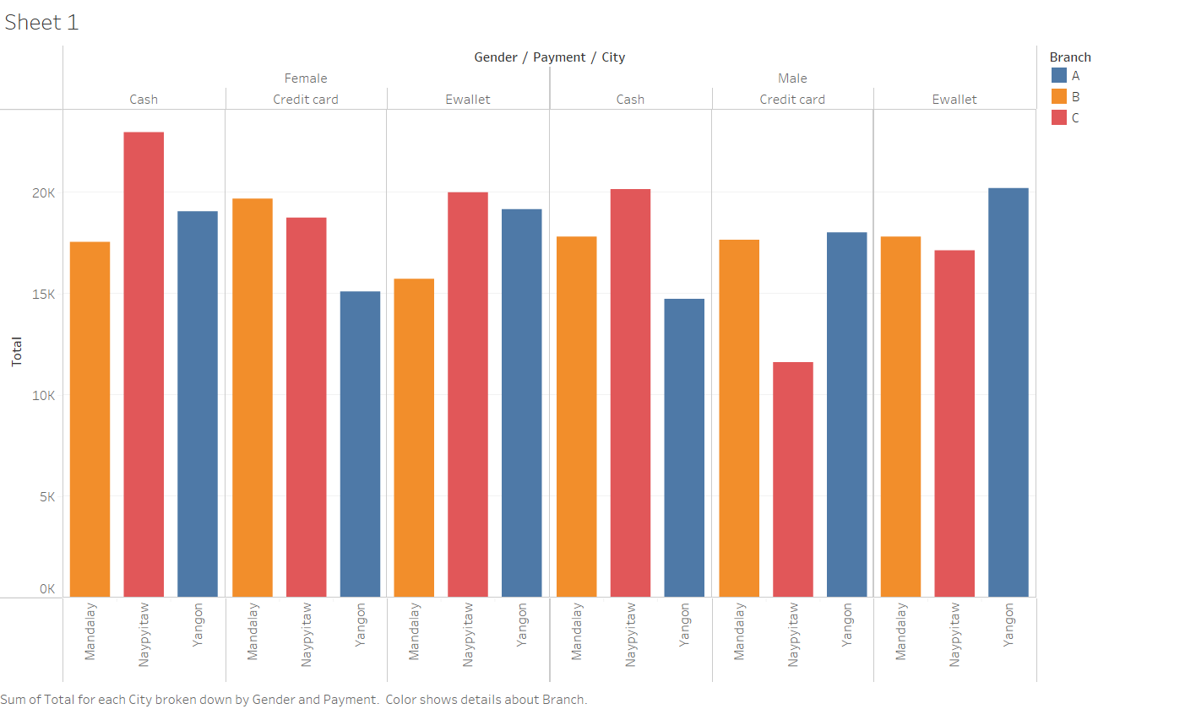
Data analysis & Visualization
Sale made in product line every hour Sales made in each city every hour Type of product sold to each customer type
Sale in each city according to gender Revenue made each product line in each branch Method of payment by each gender in all cities

Slide 6
Data Mining Algorithm & Data Pre-processing
Association rule mining is a technique used to discover patterns and correlations between variables in large datasets.
The "Supermarket Sales" dataset includes a variety of categorical variables, such as "Product line" and "Branch," which might be used to build novel connection rules.
Before executing the association rule mining method, suitable data pre-processing procedures are necessary to address any irregularities in the data, such as missing values and outliers.
The major variables in the algorithm for association rule mining will be "Product line," "Unit price," and "Quantity."
One-hot encoding is an effective method for encoding categorical data, which converts category data into a set of binary variables and standardizes the format of date row.
The association rule mining approach is a suitable fit for the "Supermarket Sales" dataset since it helps uncover interesting patterns and connections between customer-purchased commodities.
By pre-processing the data and selecting relevant parameters, we can create meaningful association rules that affect marketing and product placement decisions.

Slide 7
Data Mining
K-Means Clustering is an unsupervised learning technique that groups together related data elements based on their distance from each other.
We ran K-Means Clustering on the pre-processed Supermarket Sales dataset with three iterations, each using a different subset of the dataset.
We found that the third iteration, with the "Branch", "City", "Product line", and "Gender" variables removed, was the best, with the lowest within cluster squared errors and the most distinct clusters.
We evaluated the outcomes of the K-Means Clustering technique and found that Cluster 4 had the most data points and the highest sales, and that "Cluster 4 -> Payment Method: Ewallet" was the most critical rule.
We also performed Time Series analysis on the Supermarket Sales dataset and calculated trend lines and forecasts. We found that certain trends fit the data better than others.
These findings might be used to get insight into the algorithm's performance and output quality, and to make data-driven decisions related to marketing and product placement.

Slide 8
Data Ethics
Data ethics is crucial in any data analysis project, including the Supermarket Sales dataset on Kaggle.
Ethical concerns include protecting customer privacy, avoiding biases, and considering the impact of findings.
Legal and professional standards should also be followed to avoid legal and reputational consequences.
Approaching data analysis with a sense of duty and ethics ensures accurate and unbiased insights that benefit all parties involved.

Slide 9
Conclusion
Data pre-processing is a vital stage in the data mining process.
Data cleaning, integration, selection, and transformation are part of data pre-processing.
Data cleaning involves removing conflicts, missing values, or outliers from the dataset.
Data integration combines data from various sources into a single dataset.
Data transformation converts data into a format that can be used by a data mining system.
Normalization, scaling, and discretization are examples of data transformation.
Data pre-processing ensures that the data mining algorithm operates on a high-quality dataset.
This leads to more accurate and relevant insights.

